Slide 1
Dark Patterns
By: NyJay Nelson

Slide 2
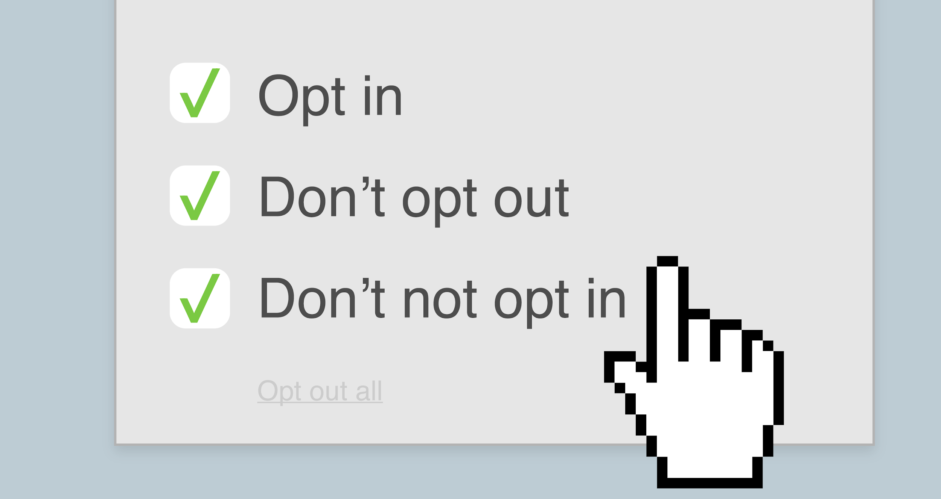

Slide 3
Introduction
What are dark patterns? Dark patterns are tricks used in websites and apps that make you do things that you didn't mean to, like buying or signing up for something. I am making this site in order to help people defend themselves by helping them learning about these dark patterns. I will make a site that has information on dark patterns, the different types of dark patterns, sites that use dark patterns, and there will even be a blog that people can use to share their experiences (along with different resources on dark patterns). After viewing my site, you will never be tricked again by these ruthless companies and you will even be able to help out your friends too!

Slide 4
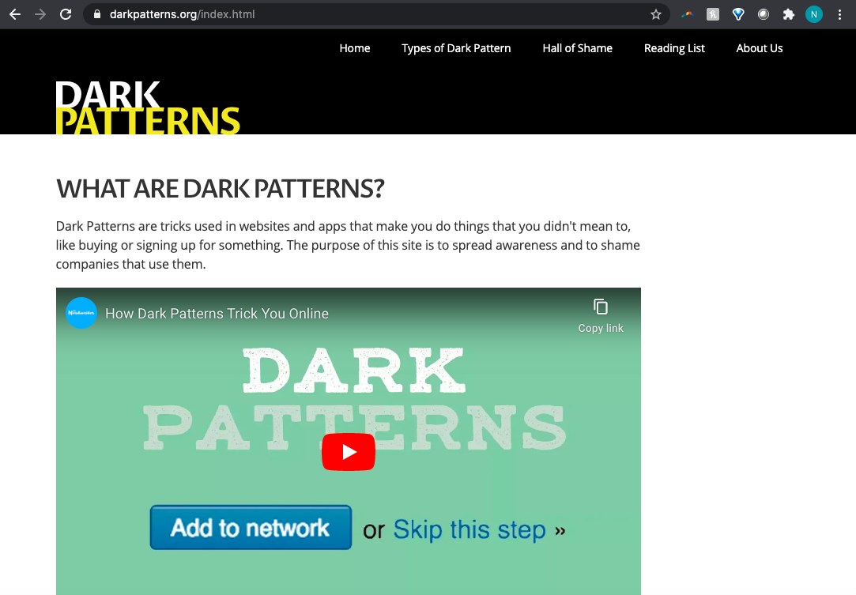
Similar Works
https://darkpatterns.org/index.html
By: Harry Brignull

Slide 5
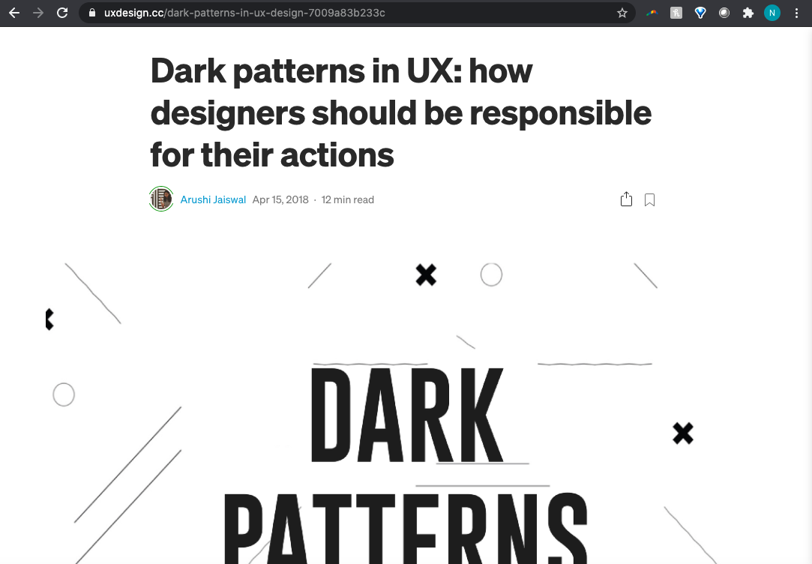
Similar Works
https://uxdesign.cc/dark-patterns-in-ux-design-7009a83b233c
By: Arushi Jaiswal

Slide 6
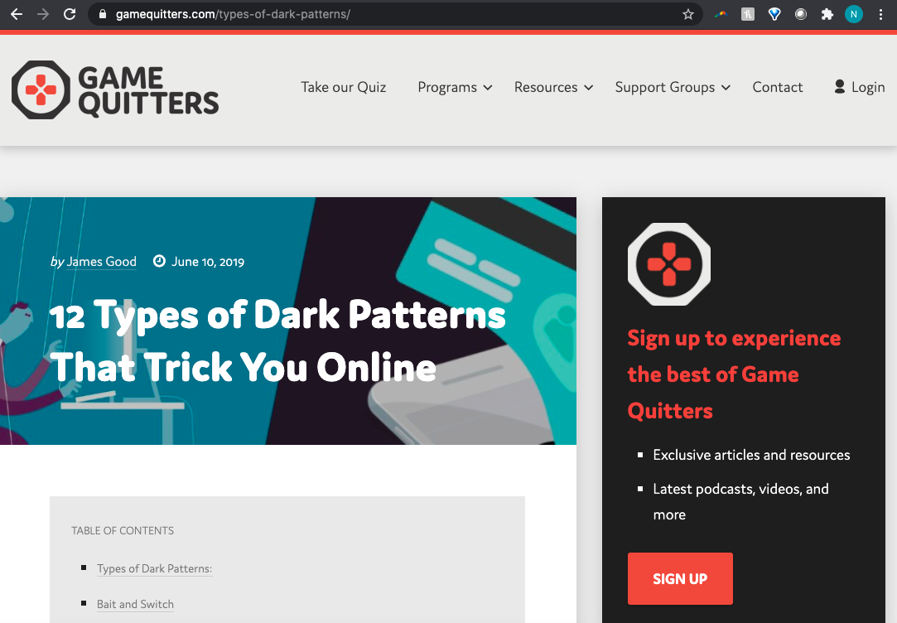
Similar Works
https://gamequitters.com/types-of-dark-patterns/
By: James Good

Slide 7
Flow Chart
Main Page → Form 1 (Confirmshaming) → Form 2 (Trick Questions)
→ Form 3 (Roach Motel) → MainPage

Slide 8
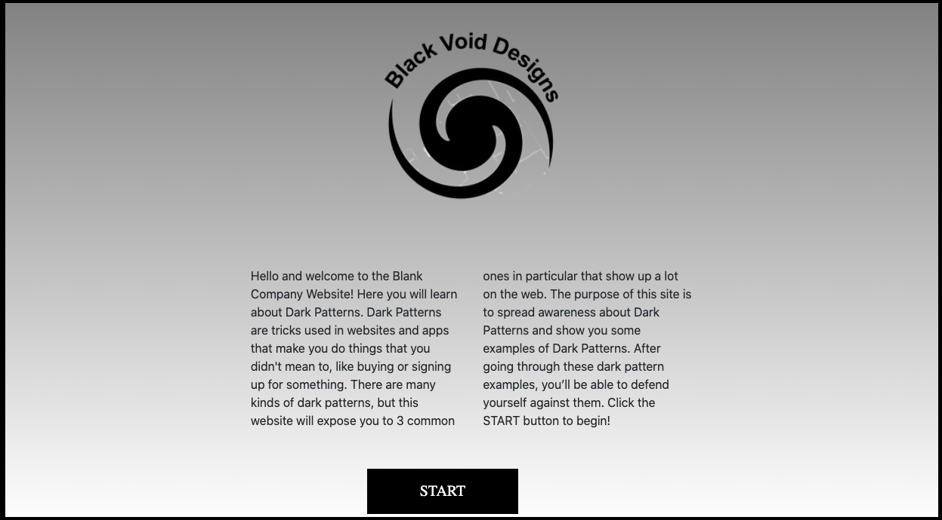
Main Page

Slide 9

Form 1 (Confirmshaming)

Slide 10
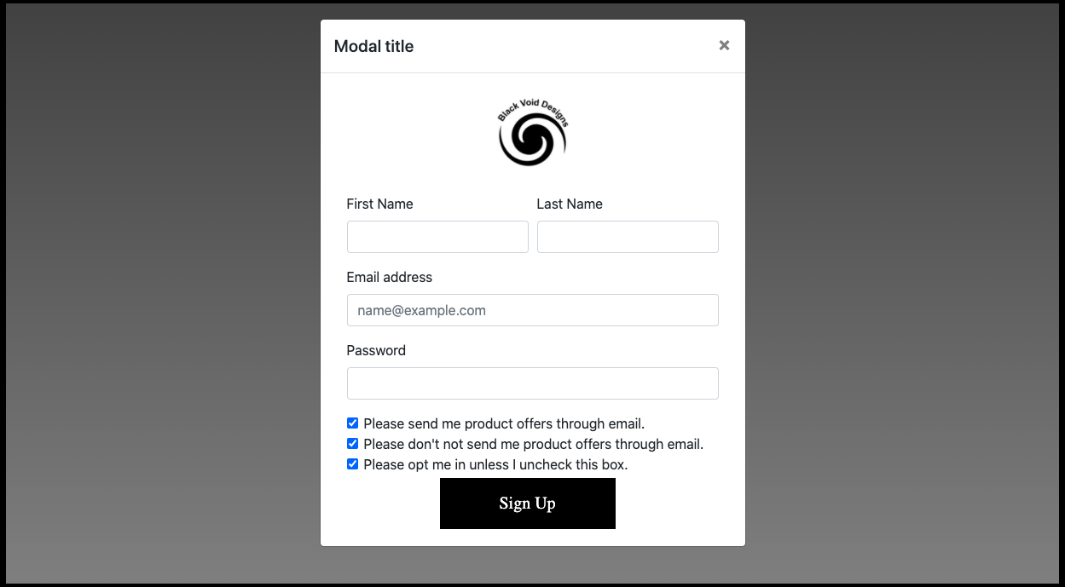
Form 2 (Trick Questions)

Slide 11
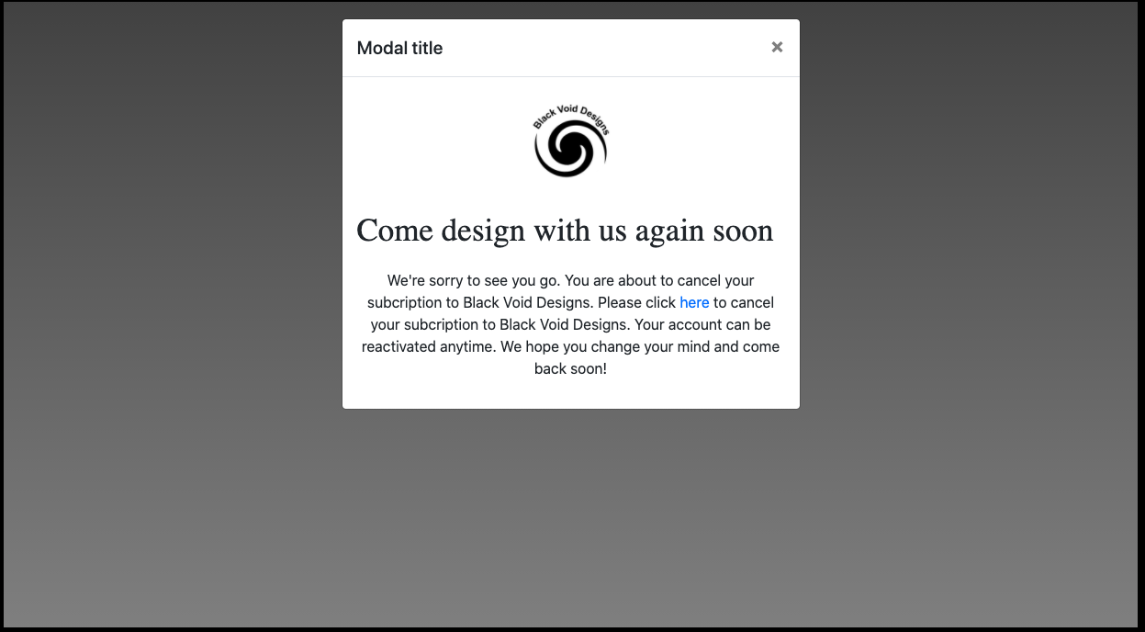
Form 3 (Roach Motel)

